Slide 1
Arduino Arrays
The arrays are defined as the data structures that allow multiple values to be grouped together in a simple way. This is an easily access method. The array is normally built from the data types like integer, reals, characters, and boolean. It refers to a named list of finite number (n) of similar data elements.
The set of consecutive numbers usually represent the elements in the array, which are 0, 1, 2, 3, 4, 5, 6, .......n.
For example, if the name of an array of 5 elements is AR, the elements will be referenced as
shown below:
AR[0], AR[1], AR[2], AR[3], and AR[4]

Slide 2
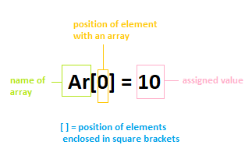
Arrays in Arduino
The array in Arduino is declared with the integer data type. It is also defined as the collection of variables, which is acquired with an index number. The array is represented as:
We can specify any name according to our choice. The array name is the individual name of an element.

Slide 3
Array Declaration
There are different methods to declare an array in Arduino, which are listed below:
o We can declare the array without specifying the size.
For example,
int myarray[] = {1, 4, 6, 7};
We can declare the array without initializing its elements.
For example,
int myarray[5];
We can declare the array by initializing the size and elements.
int myarray[8] = { 1, 4, 7, 9, 3, 2 , 4};
Now, if we specify the array as: int myarray[ 2] = { 1, 4, 6, 7 } ; The code will display errors, as shown below:

Slide 4
Features of Array
The elements of the array can be characters, negative numbers, etc.
For example,
1. int myarray[ 4 ] = { 1, -3, 4};
2. char myarray[ 6] = " Hi " ;
The size of the array should not be less than the number of elements.
For example,
int myarray[5] = { 1, 4, 6, 7 }; can be written as int myarray[8] = { 1, 4, 6, 7 };
But, it cannot be written as int myarray[2] = { 1, 4, 6, 7 };
Consider the below code in Arduino IDE.
Let's specify the array as:
int myarray[5] = { 1, 4, 6, 7 };
Now, if we specify the array as: int myarray[ 2] = { 1, 4, 6, 7 } ; The code will display errors, as shown below:

Slide 5
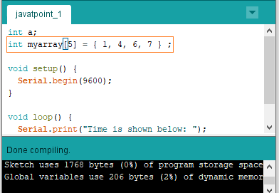
The code will successfully compile, as shown below:

Slide 6
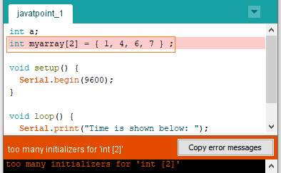
Now, if we specify the array as: int myarray[ 2] = { 1, 4, 6, 7 } ; The code will display errors, as shown below:

Slide 7
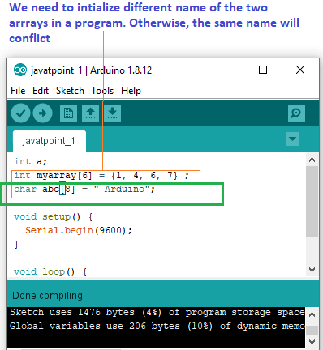
o The total elements, while specifying the char type should be (n - 1), where n is the size of the array. It is because one element is required to hold the null character in the array. For example,
Let's specify the array as char abc[8 ] = " Arduino";

Slide 8
Access of array in Arduino
The array in Arduino has zero index. It means that the first element of the array is indexed as 0.
For example,
myvalue[0] = = 1, myvalue[1] = = 2, . . . .
Let's take an array ARarduino of 6 elements. The elements of the array are shown below:
ARarduino[0], ARarduino[1], ARarduino[2], ARarduino[3], ARarduino[4], and ARarduino[5].
The last element of the array is ARarduino[5].
The last element of the array will be n-1, where n is the declared size of an array. Consider the below code.
1. ARarduino[6] = { 1, 4, 7, 6, 11, 15};
// ARarduino[4] contains value 11
// ARarduino[5] contains value 15
//ARarduino[6] is invalid

Slide 9
Arithmetic operations on Array
Let's understand the operations carried on the array.
Example 1: Sum
We can also calculate the sum of elements within an array. Let's consider an array (AR) with 4
elements. The elements are: AR[0], AR[1], AR[2], and AR[3].
To calculate the sum of the first two elements: Serial.print( AR[0] + AR[1] );
The sum of values assigned to the elements within an array will be printed.
Example 2: Division
We will divide the value assigned to the element AR[4] with 2. The resulting value will be
assigned to the variable 'z'. Consider the below code: 1. z = AR[4] / 2;
2. Serial.println ( x ); The result will be printed.

Slide 10
We need to be careful while assigning value to the array. The index number greater than the size of the array may yield invalid data. Such data is saved to random memory locations, which can cause the program malfunction or a difficult bug to find.
Note: C++ does not check the legally bound size of the declared array, while JAVA and BASIC do check.
The syntax to assign a value to an array is specified as:
myArray[0] = 5;
// we can assign any value depending on the requirements.

Slide 11
Loop Arrays
We can also use arrays inside the loop. For each element of an array, the loop counter acts as an
index element for that array. Let's understand with an example. In this example, the element over the serial port will be printed.
The code is given below:
1. for (byte i = 0; i < 6; i = i + +) // here, i++ can also be written as i+1 2. {
3. Serial.println(myArray[i]);
4. }

Slide 12
Code Examples
Let's understand arrays with some examples.
Example 1: Printing the sum of all elements
const int sizeOFarray = 5; // constant variable indicating size of array
int b[sizeOFarray] = {10, 20, 30, 40, 50}; // five values initialized to five elements of an array
int sum = 0;
void setup () {
Serial.begin(9600);
}
void loop () {
// sum of array b
for (int i = 0; i < sizeOFarray; i++ )
sum += b[ i ]; // here, sum = sum + b[i]
Serial.print('Sum of total elements of an array:') ;
Serial.print(sum) ; // It will print the sum of all elements of an array
}

Slide 13
Output
Sum of total elements of an array: 150
In the above code, we have used the const variable.
The compiler reserves the memory in Arduino. We need to use the const integer greater than zero.

Slide 14
Example 2: Average of the elements of an array
Consider the below code:
const int sizeOFarray = 5; // constant variable indicating size of array
int b[sizeOFarray] = {10, 30, 40, 55, 65}; // five values initialized to five elements of an array
int sum = 0;
int average = 0;
void setup() {
Serial.begin(9600);
}
void loop () {
// sum of array b
for ( int i = 0; i < sizeOFarray; i++ )
sum += b[ i ]; // here, sum = sum + b[i]
average = sum/5;
Serial.print('Average of the elements of the array:') ;
Serial.println(average) ; // It will print the average of all elements of an array

Slide 15
15. // there are 5 elements. So, the average will be divided by 5.
16. }
Output
Average of the elements of the array: 40

